Slide 1
HT PROTECTION SETTING GUIDELINES
P. A. Amilkanthwar
Executive Engineer
T,I&C – II
TPS,Parli
A. B. Gudsurkar
Dy.E.E.
KDPH, Pophali
&

Slide 2
Topics for Discussion
Basics of Electrical Protection system
Type of Feeders on 6.6 KV switch gear system
Types of Faults and its Effects for Motor Feeders
Different Protections used for Motor Feeders
Different Protections used for Transformer Feeders
Neutral Grounding Systems and Earth Faults.
Fault level calculations
Protections Used for Incomer and Tie Feeders

Slide 3
Type of Faults / Abnormalities Frequently Occurred in Motor Feeders
Over Loading of Auxiliary.
Excessive Temperature Rise.
Insulation Deterioration / Failure.
Three Phase Short Circuit.
Heavy fault currents
System low voltage
May collapse complete supply system.
Two Phase Short Circuit.
Heavy fault currents
System Unbalance
Single Phase to Earth Fault.
Neutral Displacement of feeding Transformer.
Rise in voltage w.r.to ground for other two phases.
Prone to second earth fault and phase to phase fault.

Slide 4
Type of Faults / Abnormalities Frequently Occurred in Motor Feeders
Single Phasing.
Unbalanced Loading.
Reduction in Torque developed (during running)
Excessive Temperature rise.
No Starting Torque.
Under Voltage.
Low Starting Torque.
Prolonged starting time.
Draws more currents.
Locked Rotor / Excessive Long Start.
Inter – turn Short
Unbalanced Loading.
Development of hot spot
Excessive Temperature rise

Slide 5
Protections Used for Motor Feeders
Motor Protection Relay
I1 Instantaneous Protection.
I2 Instantaneous Protection.
I_{s} (Thermal Over Load)
I_{eq} = (I₁² +6 I₂²)^{1/2}
Characteristic selection

Slide 6
Protections Used for Motor Feeders
Locked Rotor Protection
Basically it is a definite time over current protection.
Current Setting adopted is @ twice the full load current.
Delay is (2 + normal starting time) Sec.

Slide 7
Protections Used for Motor Feeders
Earth Fault Protection
Basically it is a definite time over current protection.
Setting recommended must be less than Fault level at that point.
Over current protection to be preferably used with suitable CBCT instead of CT summation.
E/F tripping is provided to All HT Motors with 2 sec delay

Slide 8
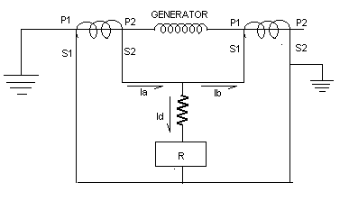
Protections Used for Motor Feeders
Differential Protection
Used only for ID, PA, BFP, CWP (above 1000 KW)
EE Make Relay type CAG 34 is used
Setting adopted 15% of rated current

Slide 9
Protections Used for Transformer Feeder
Over Current Protection
Instantaneous Over Current Protection.
IDMT Over Current Protection.
Earth Fault Protection
Winding Temperature Protection
Alarm 85⁰ C and Trip 95⁰ C
Buccholz Protection

Slide 10
Protection System
Cause of Operation of Protection is the Fault.
Protection System is Basically Designed,
To detect the fault at its earliest possible stage.
To give protection to the equipment against secondary damage.
To avoid the equipment to run out side the capability specified.

Slide 11
Type of Feeders on 6.6KV Switch Gear
Motor Feeders
Transformer Feeders
Tie Feeders
Incomer Feeders
Bus PT Cubical / Line PT Cubical

Slide 12
Unbalanced Loading
Balanced and unbalanced systems
Sequence components
Positive sequence component
I₁ = 1/3 (I_{R} +a² *I_{Y} + a * I_{B})
Negative sequence component
I₂ = 1/3 (I_{R} +a *I_{Y} + a² * I_{B})
Zero sequence component
I₀ = 1/3 (I_{R} +I_{Y} + I_{B})
Effect of negative sequence component on rotating electrical machine.

Slide 13
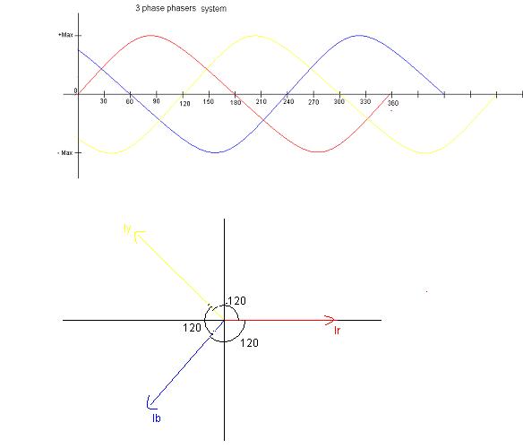
Balanced Phases

Slide 14
Neutral Grounding Systems
1. Ungrounded System.
2. Neutral Grounding with solid Earth.
3. Neutral Grounding with Resistance.
a. Neutral Grounding with High Resistance.
b. Neutral Grounding with low Resistance.
c. Neutral Grounding with NGT and Resistance.

Slide 15
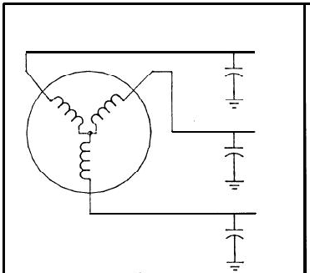
Ungrounded System.
Transient over voltage due to arcing faults
Location of ground fault is difficult

Slide 16
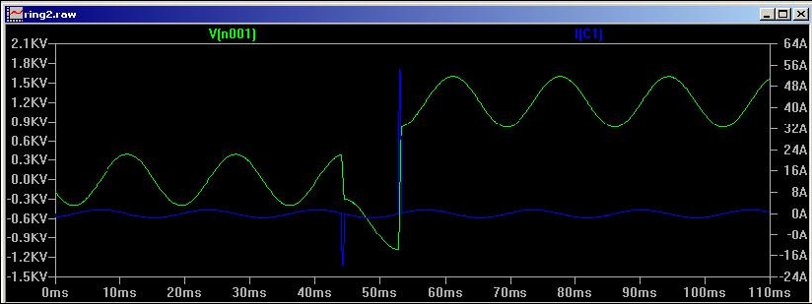
Transient over voltage due to arcing faults

Slide 17
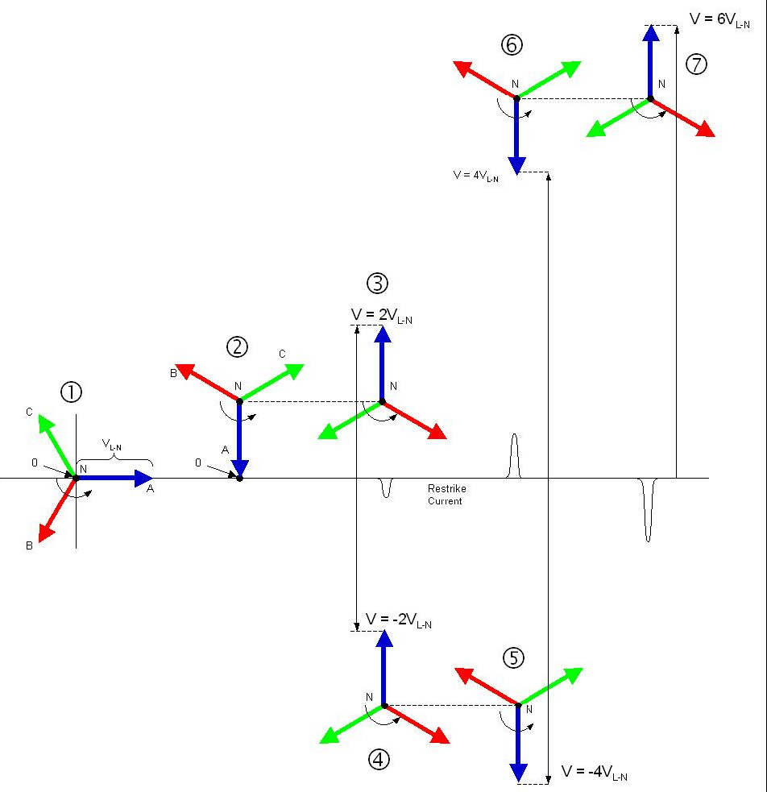

Slide 18
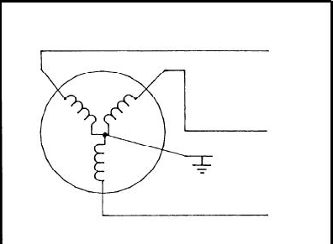
Neutral Grounding with solid Earth.
High Fault currents against ground fault.
Introduction to negative sequence component while ground fault.
Heavy burning and melting effects to the equipments against ground fault.
Poor system continuity and reliability

Slide 19
Why Limit the Current Through Resistance Grounding?
To reduce burning and melting effects in faulted electric equipment, such as switchgear, transformers, cables, and rotating machines.
To reduce mechanical stresses in circuits and apparatus carrying fault currents.
To reduce the momentary line-voltage dip occasioned by the occurrence and clearing of a ground fault.
To secure control of transient over-voltages while at the same time avoiding the shutdown of a faulty circuit on the occurrence of the first ground fault.

Slide 20
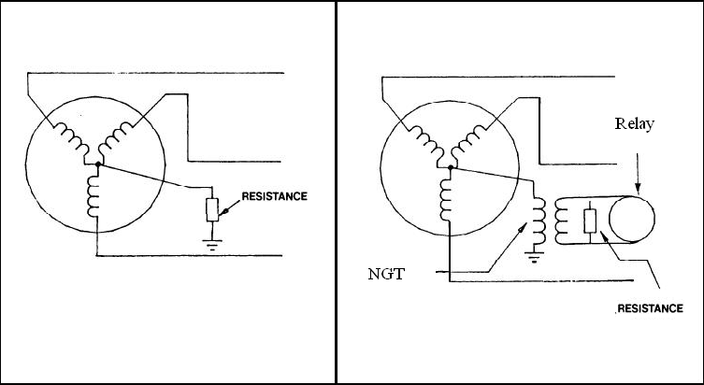
Neutral Grounding with Resistance / Neutral Grounding Transformer

Slide 21
Fault level calculations
Fault level against dead short circuit fault with known source fault level.
Fault level against single phase to earth fault.

Slide 22
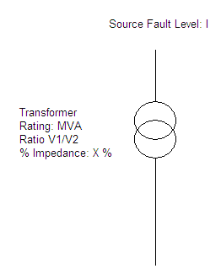
Fault Level Against Dead Short Circuit Fault
Source Impedance in ohm (Xs)
= (v1) / (1.732*source fault level)..
Source Impedance in p.u. (Xs p.u.)
= (Source Impedance in ohm) / (Base Impedance in ohm.)
Base Impedance in ohm
= (V1*V1*10⁻⁶) / (MVA)
Total Fault Impedance = (Xs p.u.)+(X_{T} p.u) p.u.
Fault current in p.u. =1 / (Total Fault Impedance in p.u.)
Fault level in Amps = (Fault current in p.u. )*(Rated current on V2 side) Fault level calc.xls

Slide 23
Fault level against single phase to earth fault.
Transfer the NGR to primary side of NGT if NGT is Not used the value of NGR can be directly taken for calculations purpose.
Compute Transformer and network impedance.
Calculate combine effective impedance for ground fault.
Calculate fault current.

Slide 24
Protections Used for Incomer and Tie Feeders
IDMT Over current protection:
Calculate Nominal load on the board.
Add 10 % extra and consider next available PSM on the relay.
Verify the trip time is more than the starting time of biggest auxiliary, with starting current of biggest auxiliary in vector addition with nominal load.
if not go to next PSM available and repeat step 3.

Slide 25
Protections Used for Incomer and Tie Feeders
High set Over current setting guidelines
PSM Must be less than the fault level at that point.
PSM should be greater than nominal load on the down stream + starting current of biggest auxiliary connected on the down stream of this breaker.
It must not be less than the PSM setting on any of the down stream breaker.

Slide 26
Protections Used for Incomer and Tie Feeders
Time delay setting to High set:
The Highest delay should not be more than 300 msec.
The step of 100 msec. is preferably used for every step of grading.
Where there are more than 3 steps involved than accordingly lower step may be used.
Tripping on Earth fault is not to be provided.

Slide 27
Thank You

